Slide 1
I-69 Congressional Caucus Briefing
A Freight Corridor Connecting the American Heartland
May 18, 2016
I-69 DC Fly-In 2016
Delegation Representing the Eight State Corridor

Slide 2
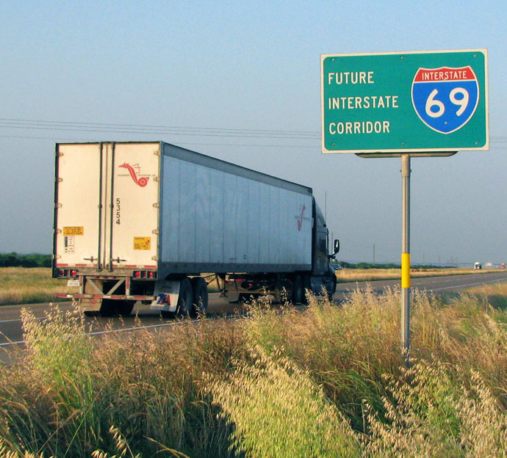
I-69 and Freight Movement

Slide 3
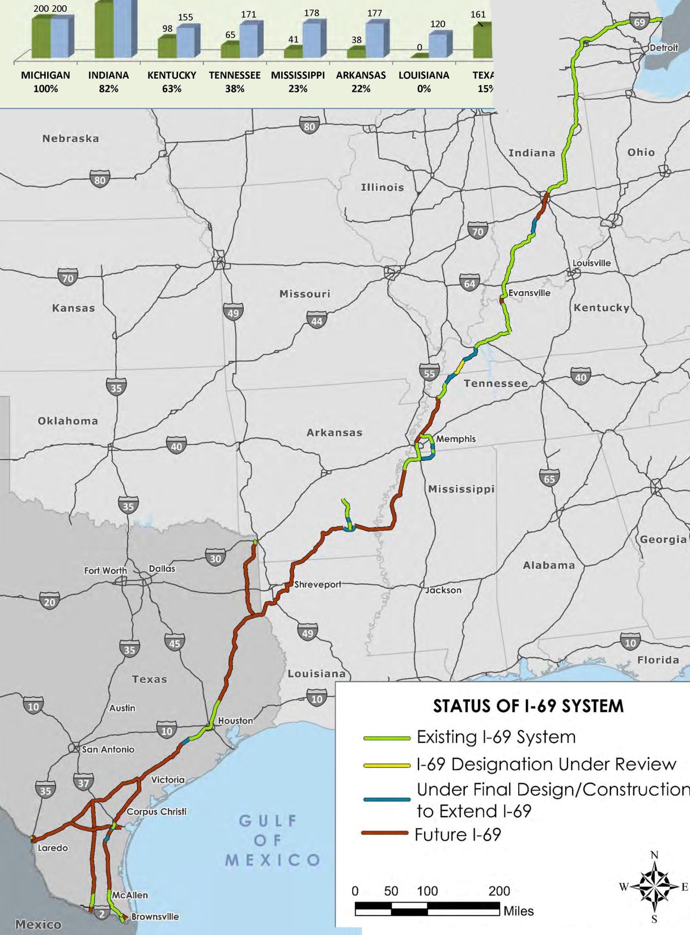
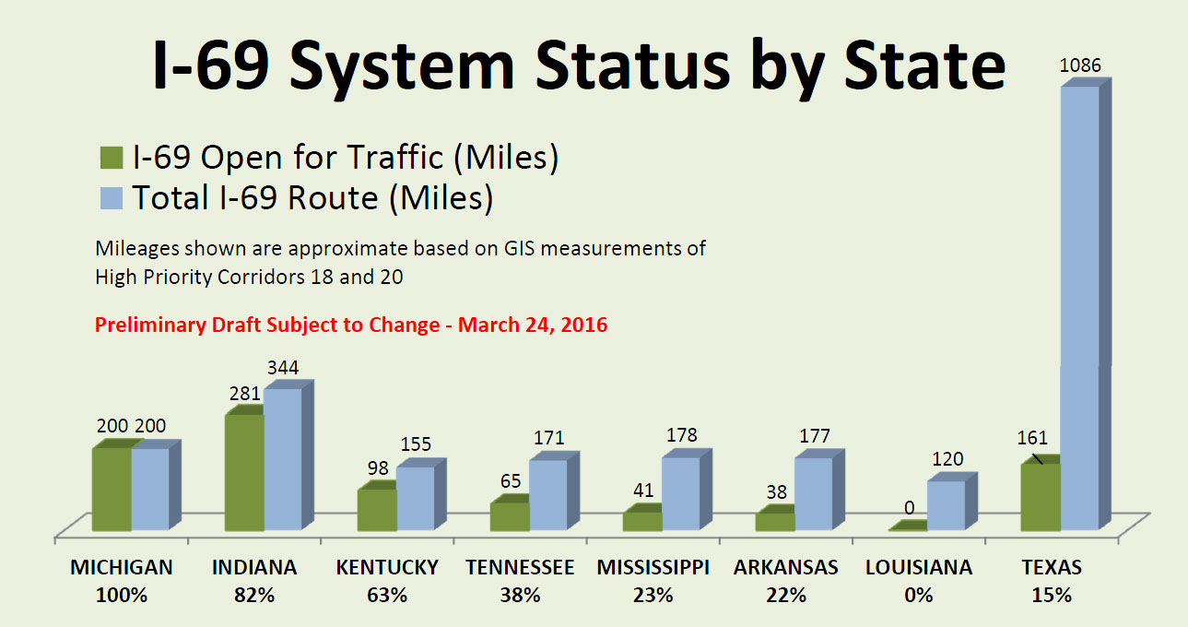
National Status 2016
TO BE UPDATED

Slide 4
Texas

Slide 5
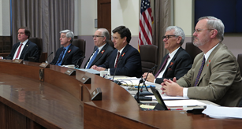
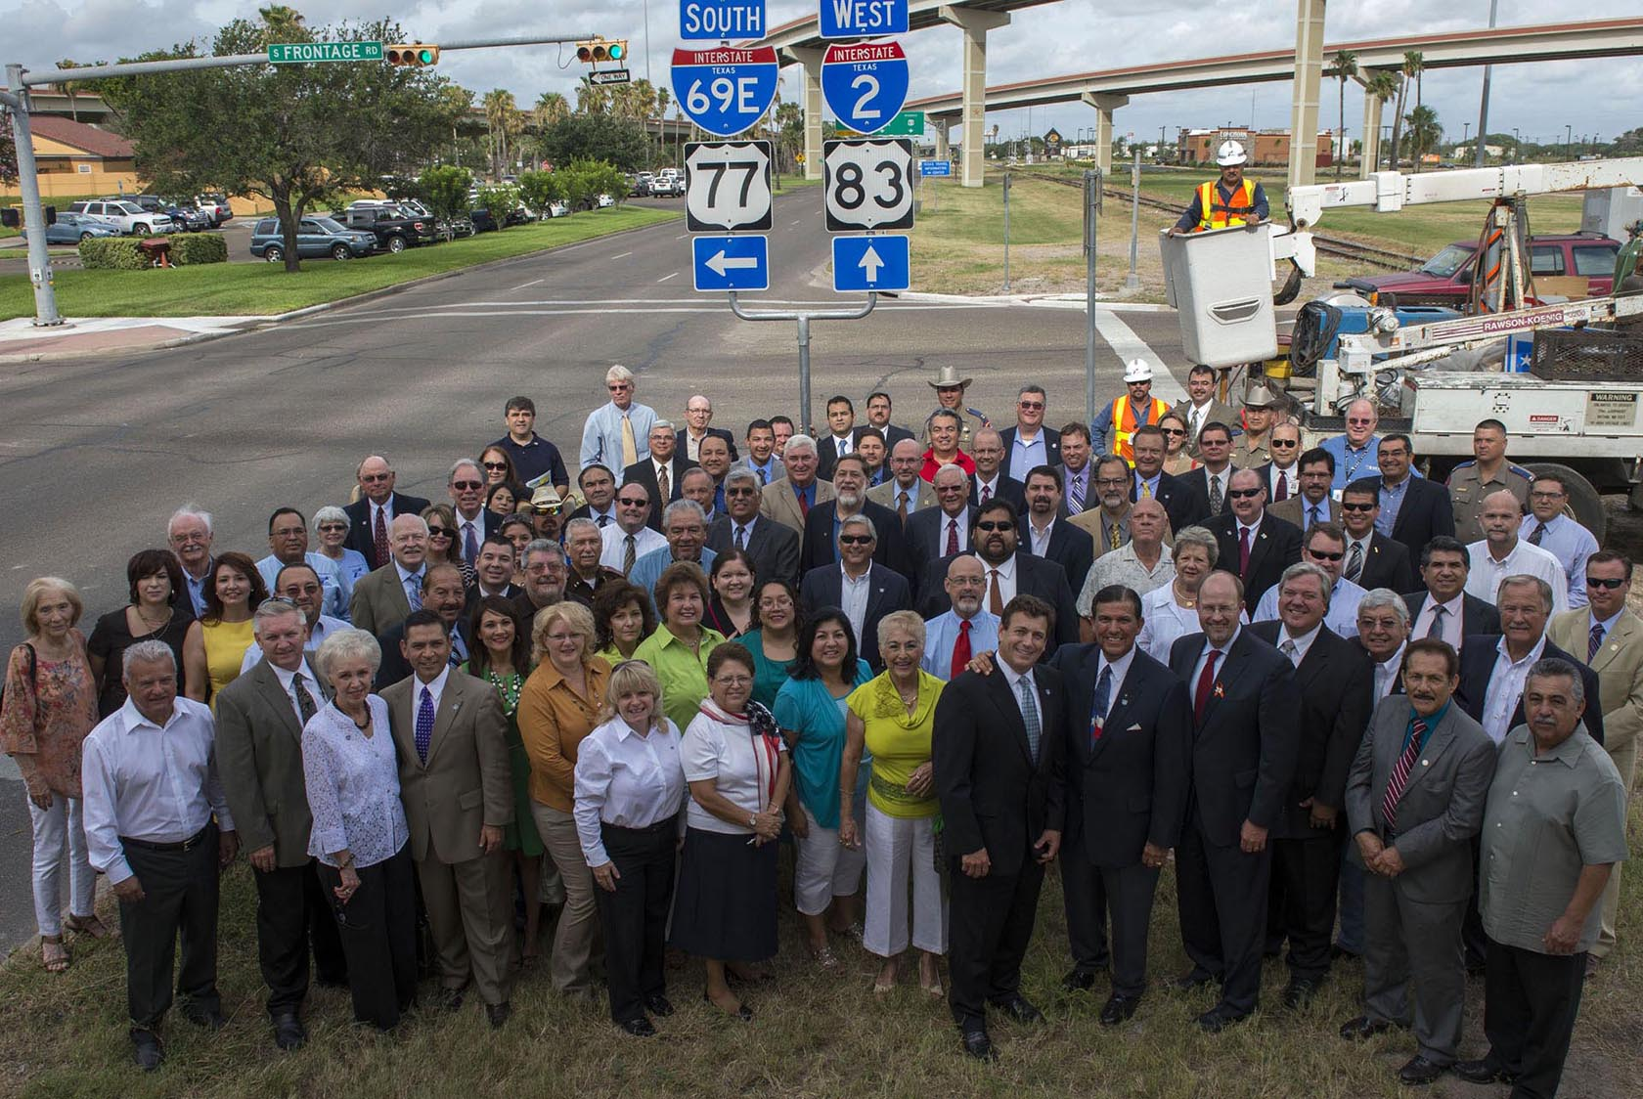
Texas Department of Transportation
I-69 UPDATE
Commissioner Jeff Austin, III

Slide 6
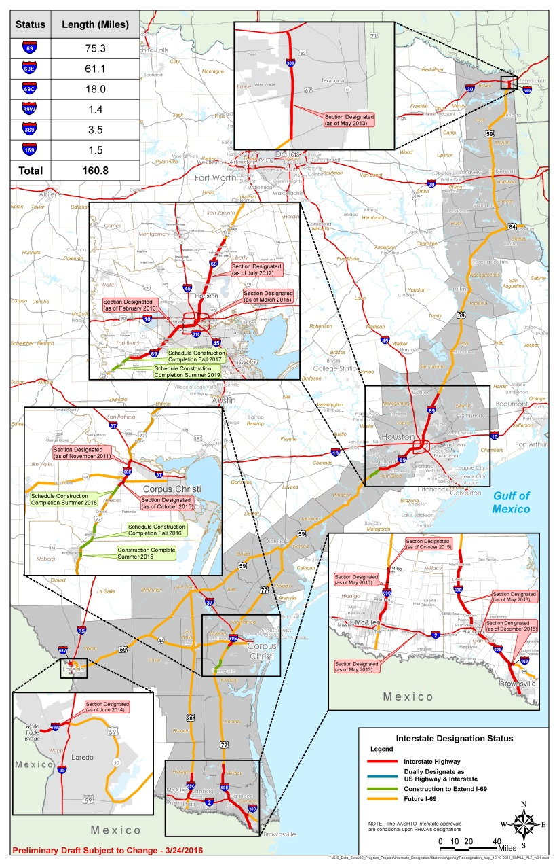
Interstate Designation Status for I-69 In Texas
Notes:
REFERENCE THE HANDOUT This map shows the I-69 Texas route that was laid out in federal legislation.
Our state has designated almost 161 miles of highways as part of the I-69 system in Texas. The most recent designation occurred in December of last year when 1.5 miles of Interstate 169 (a spur off of I-69E) was added to the system in the City of Brownsville.
In December of last year, the federal FAST Act added approximately 80 miles of State Highway 44 in south Texas from City of Corpus Christi to the City of Freer to the network of highways to serve as the I-69 Texas System. This increased the total route mileage to approximately 1,086 miles.
Additionally, approximately 46 miles of US 83 between Harlingen and Mission in the Rio Grande Valley has been designated as Interstate 2, connecting I-69C and I-69E.

Slide 7
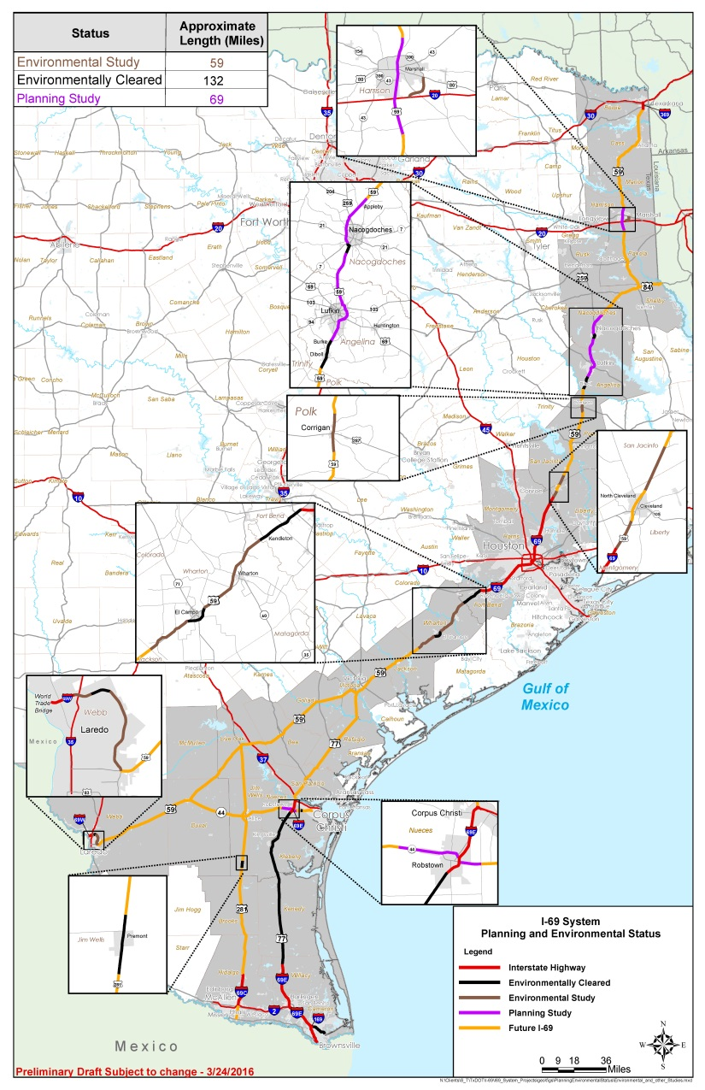
I-69 System Planning and Environmental Review Status
Notes:
REFERENCE THE HANDOUT
We continue our planning and environmental clearance processes that will enable us to build more of the I-69 system roadways to interstate standards and ultimately designate them on our state highway system as interstate.
Our focus has been primarily on roadways that are adjacent to existing interstates. By positioning our studies next to these interstates, it will ultimately be easier procedurally for AASHTO and Federal Highway Administration to concur that these roadway sections meet interstate standards and can thus be designated as part of the I-69 system in Texas.
In March of this year, TxDOT also completed an I-69 “Implementation Strategy”. This was a collaborative process involving TxDOT Headquarters and District personnel, I-69 Advisory Committee Members and other local stakeholders. It is intended to serve as a tool to assist TxDOT Districts in prioritizing and developing future projects and managing and tracking the remaining I-69 System projects. It will also serve as an important and informative tool that our state’s I-69 Advisory Committee can use to continue engaging stakeholders about the I-69 System.
As it represents a “snapshot in time”, if you will, the Implementation Strategy will be updated as the program unfolds and evolves over time.

Slide 8
I-69 Funding Program
There is limited funding from federal and state programs, which are subject to congressional and legislative actions.
In 2012, the I-69 Advisory Committee recommended innovative funding and project development strategies such as
tolling,
tax-increment financing,
public private partnership agreements, and
partnerships with local governments
About $198 million from the Proposition 1 transportation funding ballot initiative is being used to develop ten I-69 System projects.
Last year’s passage of both Texas’ Proposition 7 ballot initiative and the FAST Act will provide an additional source of funding, some of which may become available for I-69 development.
Notes:
REFERENCE THE BULLETED ITEMS ON THE SLIDE

Slide 9
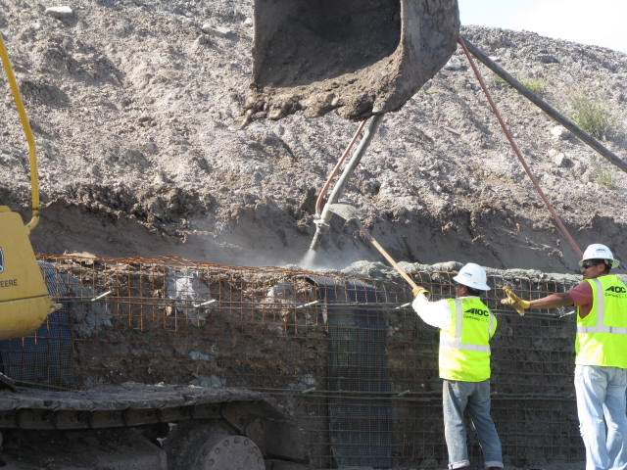
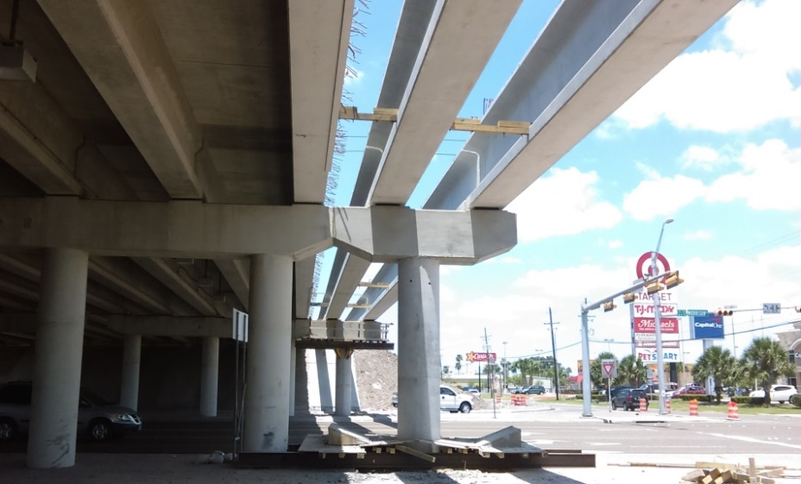
I-69 Development Expenditures
Since 2010, approximately $1.47 billion has been committed to fund planning/environmental studies, final design & right-of-way (ROW) acquisition and construction along the I-69 Texas System routes.
Notes:
REFERENCE THE BULLETED ITEM ON THE SLIDE, AUGMENTED BY ANY ADDITIONAL NARRATIVE DESIRED

Slide 10
Texas Freight Mobility Plan
In January 2016, the Texas Transportation Commission adopted TxDOT’s Texas Freight Mobility Plan.
It is the agency’s first comprehensive multimodal transportation plan that focuses on the state’s freight transportation needs.
Developing and completing new corridors such as I-69 is identified as a specific priority in the Freight Plan.
Notes:
REFERENCE THE BULLETED ITEMS ON THE SLIDE, AUGMENTED BY ANY ADDITIONAL NARRATIVE DESIRED

Slide 11
Louisiana

Slide 12
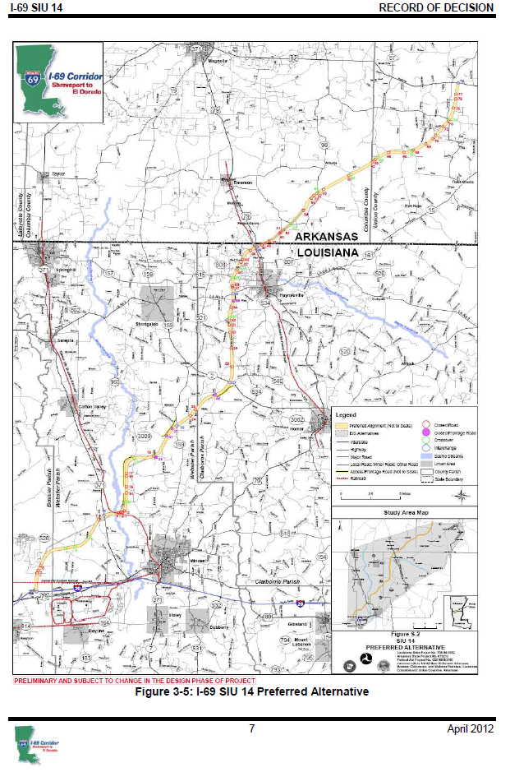
I-69 SIU 14 Preferred Alternative North of I-20
SIU 14 El Dorado, AR to Haughton, LA
2012 Environmental Clearance
Preferred Alternative Alignment Mileage:
Arkansas 30 miles (approx.)
Louisiana 40 miles (approx..)
70 miles total
Estimated Cost to build:
Arkansas $475 Million (2011$)
Louisiana $778 Million (2011$)
$1.253 Billion

Slide 13
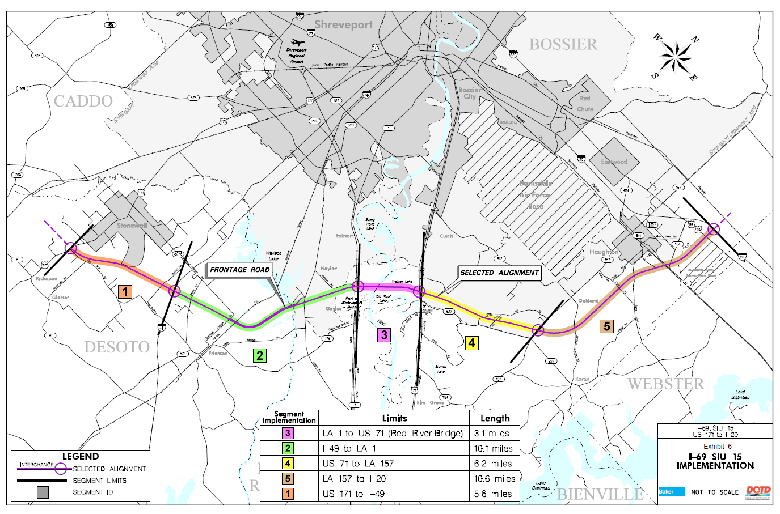
I-69 SIU 15: Haughton, LA – Stonewall, LA
2014 Environmental Clearance
Mileage: 35.6 miles
Estimated Cost: $1.170 Billion

Slide 14
Section of Independent Utility (SIU) 16 Tenaha TX – Stonewall LA
TxDOT is lead agency for formal NEPA Process under 2002 Agreement
NEPA process not complete for SIU 16
SIU 16 is part of Texas I-69 Segment One – Alternate US 84 Route to TX/LA border

Slide 15
Planned Activities – I-69 in Louisiana
Focus on the Red River Bridge segment (LA 1 to US 71) of SIU 15 – estimated cost: $340 (+) Million
At approx. total cost of $2 Billion for LA portion of SIU 14 + SIU 15 alone (not counting cost for LA portion of SIU 16), I-69 is beyond current and projected revenues in Louisiana
LA DOTD supports establishment of a special Federal program and fund to complete I-69 and other similar facilities

Slide 16
Arkansas

Slide 17
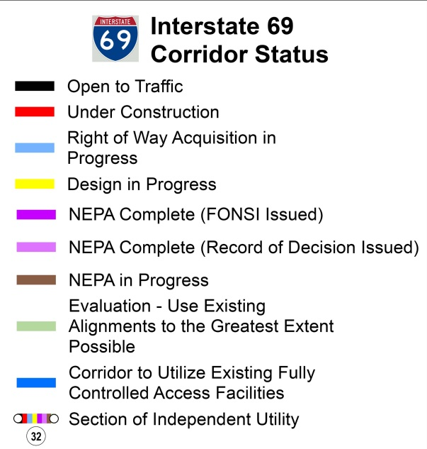
I-69 in Arkansas
Preferred Alignment Identified
184 miles
Estimated Cost to Complete - $3.0 Billion
4 “Segments of Independent Utility” (SIUs)
Notes:
The environmental phase of the I-69 corridor in Arkansas is complete and a preferred alignment has been identified.
The Interstate 69 Corridor in Arkansas crosses the Mississippi River into Arkansas just north of Arkansas City. It will continue westward staying south of Monticello and north of El Dorado before turning southwestward to Shreveport, Louisiana – it essentially runs along the southern border of Arkansas. The I-69 Connector (Future I-530) will provide a connection from Interstate 530 in Pine Bluff to the I-69 Corridor near Monticello.
The total estimated cost to construct approximately 184 miles of Interstate 69 in Arkansas is $3.0 billion. The mileage and cost include 1) the I-69 Connector – 42 miles and $616 million; and 2) Arkansas’ portion of the Great River Bridge – 16 miles and $910 million.
There are 4 “Sections of Independent Utility”
Arkansas has received over $300 million in earmarked funding for this corridor.

Slide 18
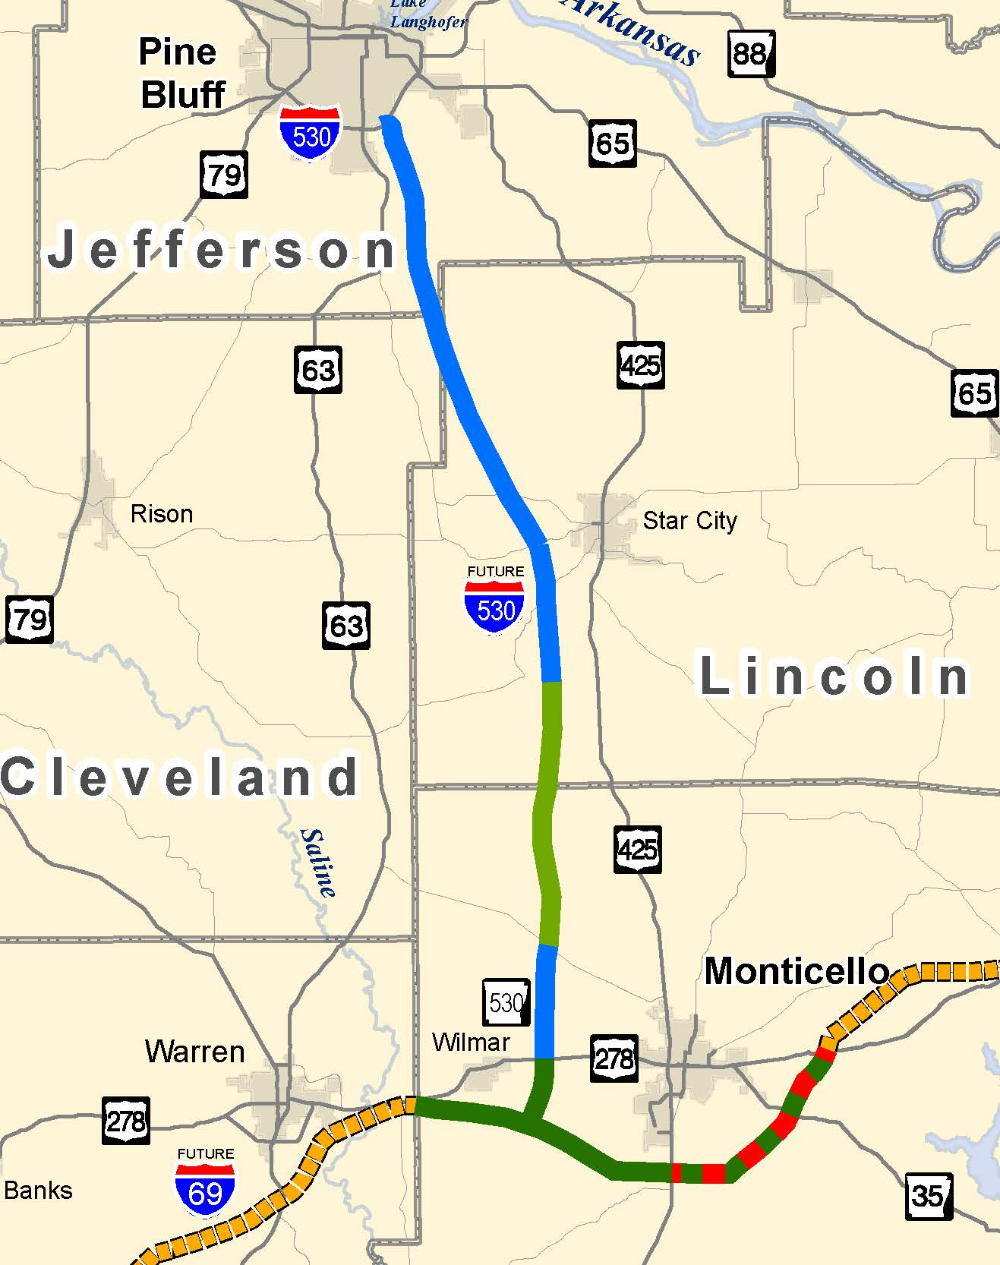
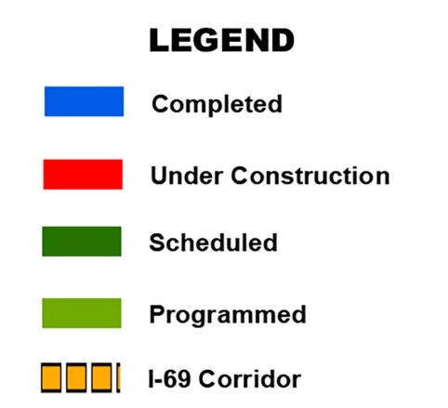
I-69 Connector
I-69
Connector
Environmental Studies Complete / Preferred Alignment Selected
42 miles
Right-of-Way Purchased for 4-lane Interstate Facility
Initial Construction 2 Lanes
Current Estimate is $616 million for the ultimate 4-lane Interstate Facility
Notes:
The Interstate 69 Connector is a 40.8 mile extension from Interstate 530 in Pine Bluff to the Interstate 69 Monticello Bypass - construction of two lanes of the ultimate four lane facility are underway.
22.5 miles are complete
6.5 miles are under construction
Job 020356, Hwy. 212-Hwy. 11/425 Connector (Base & Surf)
County: Lincoln
Length: 6.5 miles
Award Amount: $32.2 million
Estimated Completion Date: Mid 2015
Funding has not been identified to construct 10.5 miles of the initial 2-lanes from the Highway 11/425 Connector to Highway 35.

Slide 19
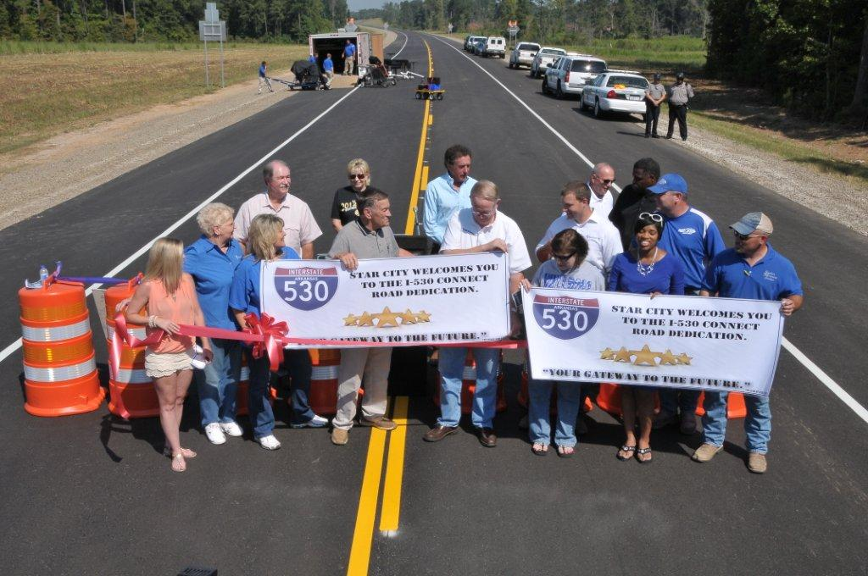
I-69 Connector Funding Summary
Status | Miles | Total ( millions)
Complete | 29.0 | $ 186
Scheduled | 2.8 | $ 14
Unfunded | 10.5 | $ 52
Sub-Total (2 lanes) | 42.3 | $ 252
Unfunded (4-lane Interstate) | ------ | $ 364
Totals | 42.3 | $ 616
Notes:
The Completed, Under Construction and Scheduled totals shown on this slide are only 2-lanes of the ultimate 4-lane Interstate.
The Unfunded totals shown include completing the initial 2-lanes from the Highway 11/425 Connector to Highway 35 and the additional 2-lanes for the entire route.
All funds spent to date on the Connector are Earmarks and State Match.
The 2.8 miles scheduled are for the segment between Hwy. 278 and the Monticello Bypass.
As you can see, $520 million is needed to complete the Connector as a freeway facility from Pine Bluff to Future Interstate 69.

Slide 20
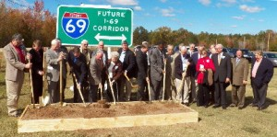
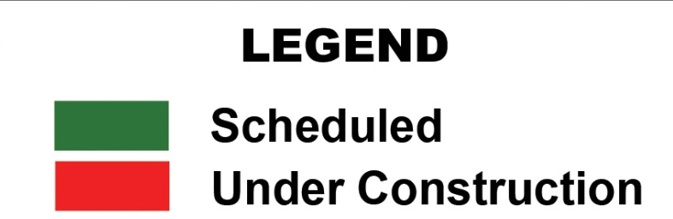
Monticello Bypass
Notes:
The Monticello Bypass is the only portion of Future Interstate 69 that is currently funded for construction.
This 19.8 mile segment will cost $92 million.
The available earmark and state funding will build 2-lanes of the ultimate 4-lane interstate.
The Eastern portion is under construction.
Job 020471, Hwy. 425-Hwy. 278 East (Grading & Structures)
Length: 8.5 miles
Award Amount: $13.2 million
Estimated Completion Date: Mid 2016
The Eastern portion Base and Surfacing contract will be let as soon as the Grading and Structures project is complete.
The Western portion will include construction of an extension of the I-69 Connector from Hwy. 278 to the bypass.
The Grading and Structures portion of the Western portion is scheduled to be let in 2016.

Slide 21
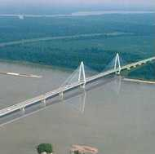
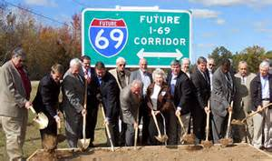
I-69 Funding Summary
Status | Miles | Total (millions)
Complete | 29.0 | $ 186
Under Construction | 8.5 | $ 13
Scheduled | 11.3 | $ 61
Unfunded | 135.2 | $ 2,772
Totals | 184.0 | $ 3,032
Notes:
The Unfunded portion of Future Interstate 69 includes $910 million for Arkansas’ part of the Great River Bridge. This table does not include the cost for the I-69 Connector.

Slide 22
Mississippi

Slide 23
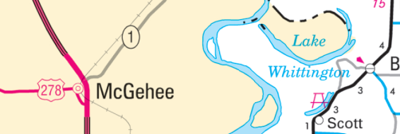
SIU 9
SIU 10
Completed & Open to Traffic
Under Construction
Unfunded Portions
AHTD Portion
SIU Limits
SIU 11
I-69 in Mississippi
SIU 12

Slide 24
Funding
Status | Miles | Total (in millions)
Completed | 39 | $82.0
Under Construction | 26 | $649.4
Unfunded | 113 | $1,827.0
Totals | 178 | $2,558.4

Slide 25
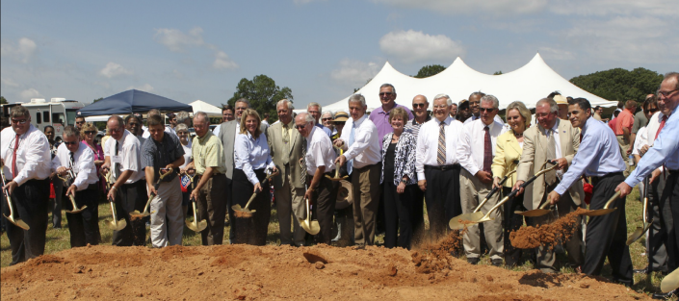
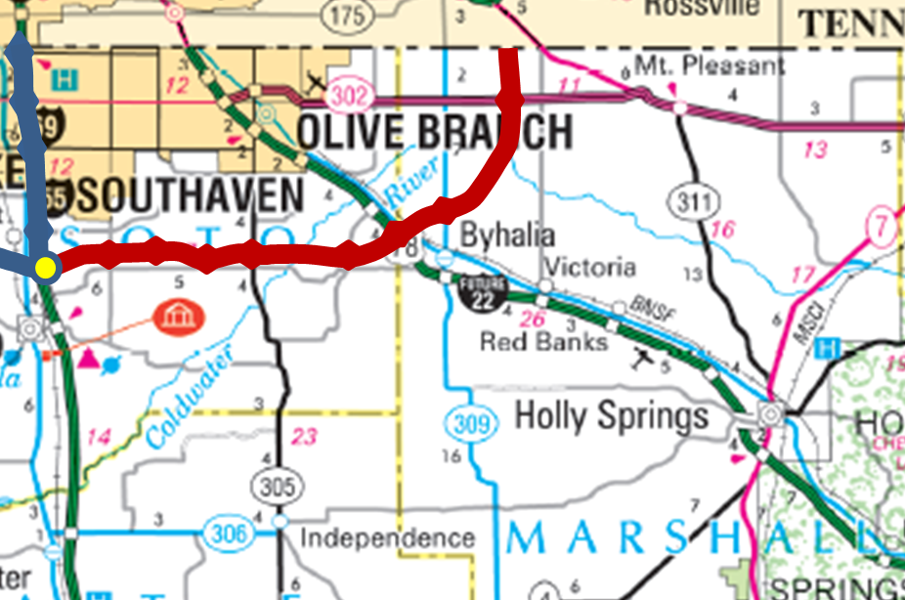
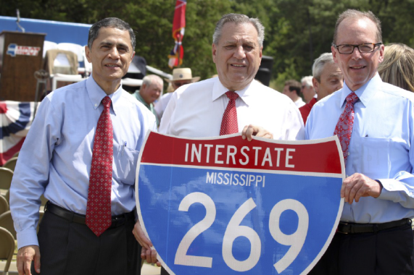
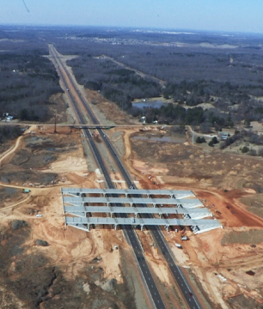
SIU 9
Additional Loop 269 contracts be let this year

Slide 26
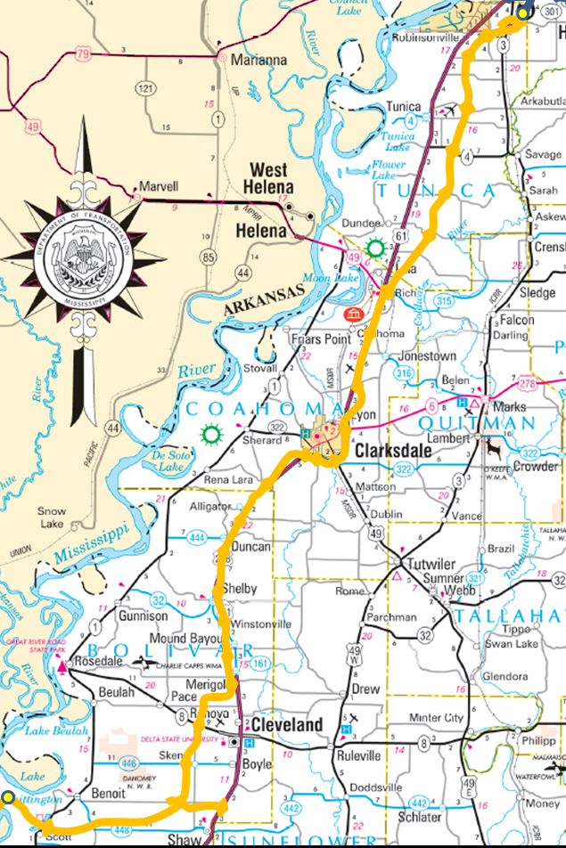
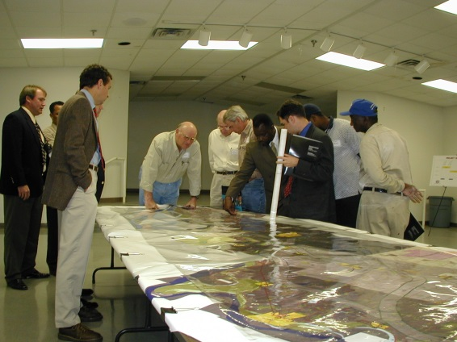
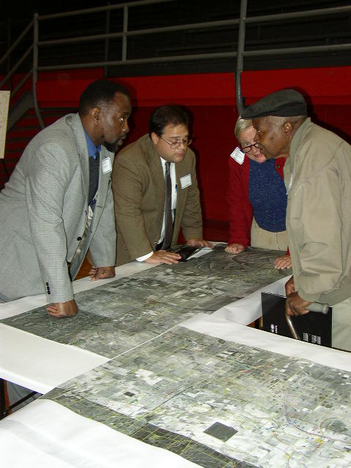
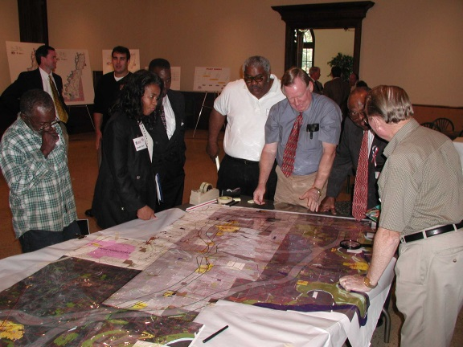
SIU 11
Unfunded Portions SIU Limits

Slide 27
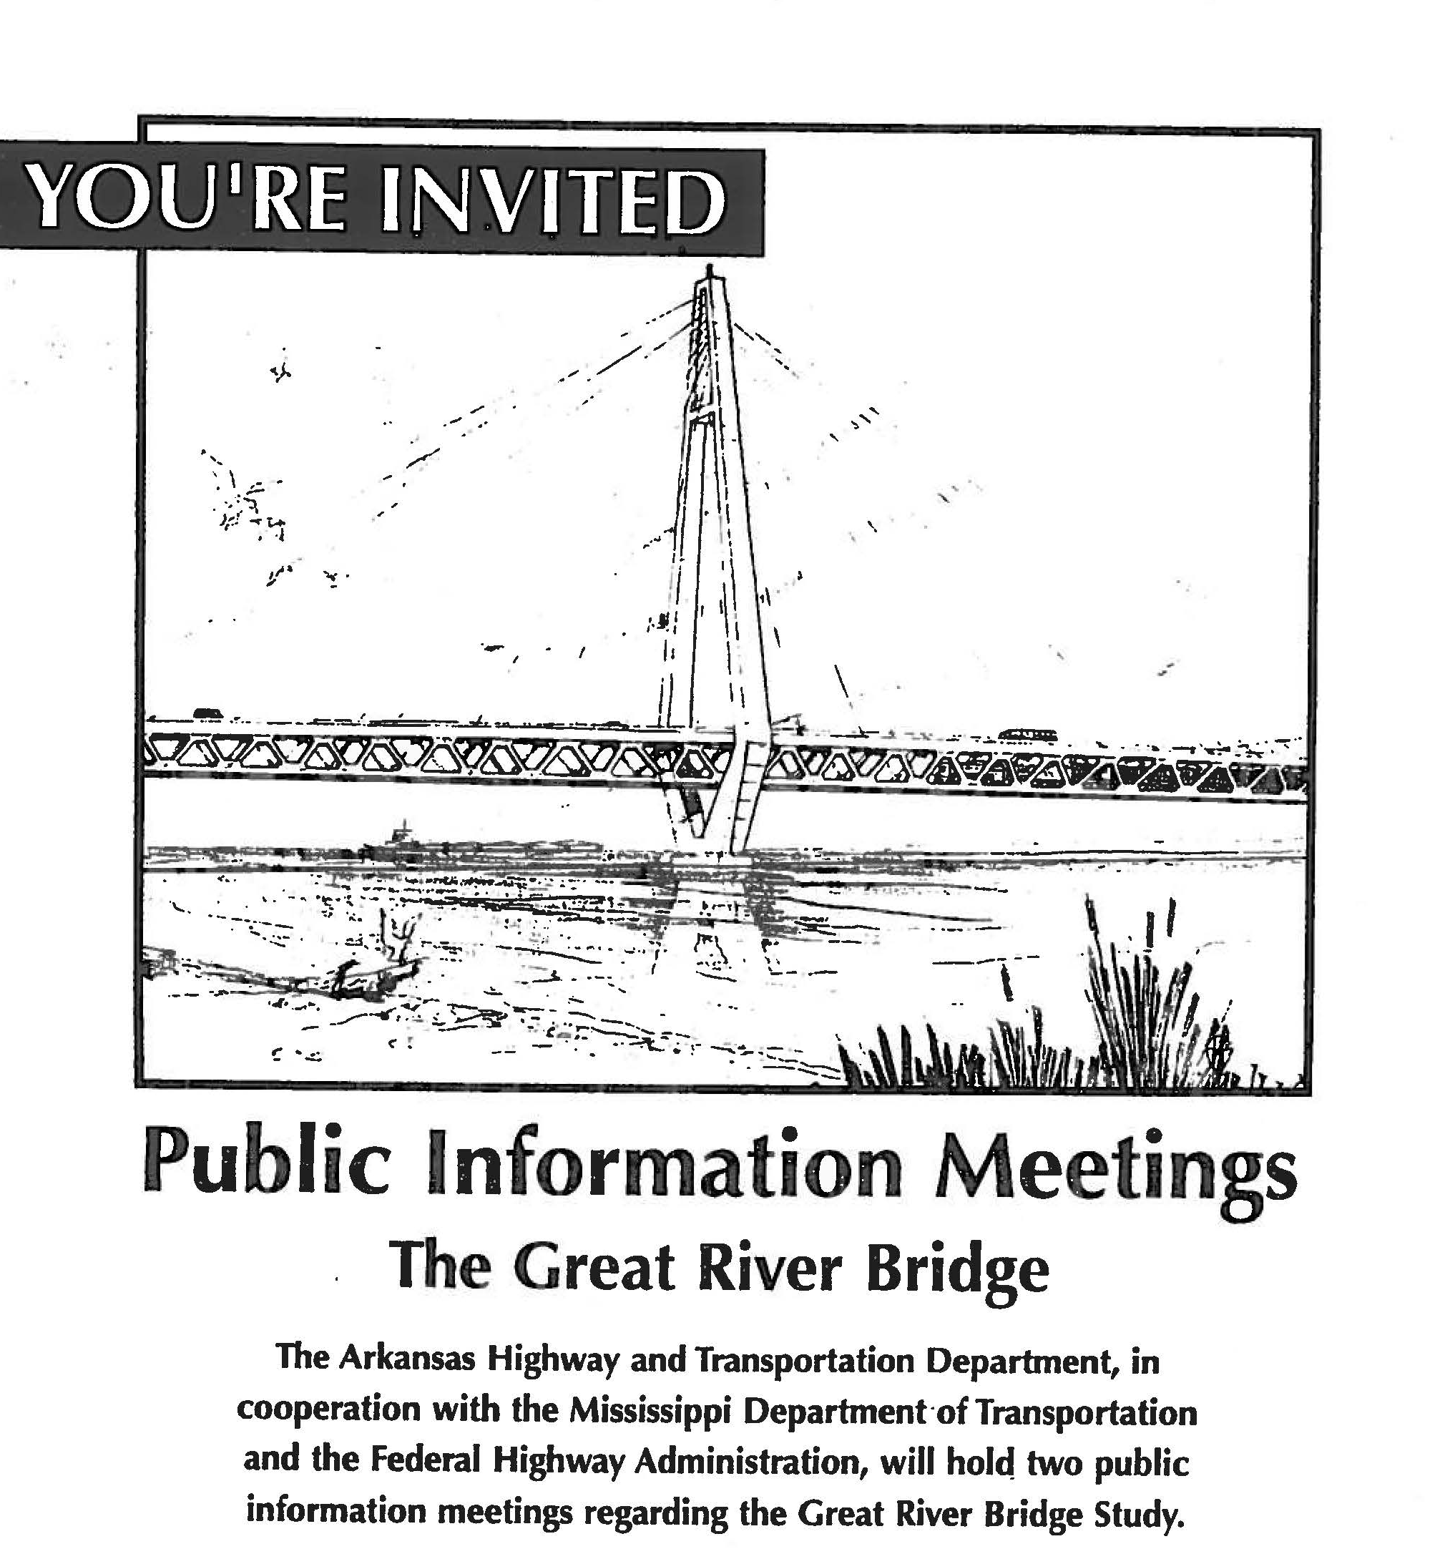
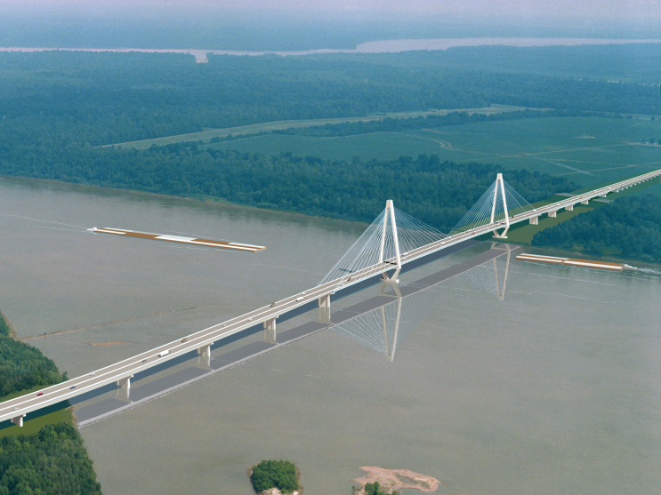
SIU 12
*
*
AHTD Portion Unfunded Portions SIU Limits
* Images courtesy of AHTD

Slide 28
Tennessee

Slide 29
Tennessee – SIU 7, 8 and 9
Kentucky
171 Total Miles
65 Open to Traffic
7
ROW Phase Underway
8
Planning and Engineering Phase
9
MEMPHIS
Complete
Mississippi

Slide 30
Kentucky

Slide 31
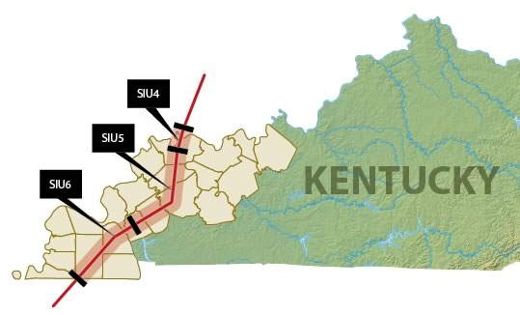
In Kentucky
All sections south of Ohio River could be under shield in the next 2-3 years.

Slide 33
I-69 Ohio River Bridge
2008 estimated cost: $1.4 billion, including nearly 8 miles of approaches and new terrain build.
2014 estimated cost: Approx. $850 million, based on shortened route and cost savings identified by construction firm which built new I-70/Stan Musial Bridge at St. Louis (pictured at right).
2016 State Highway Plan includes funding for design, right-of-way and utilities work related to the bridge

Slide 34
Indiana

Slide 35
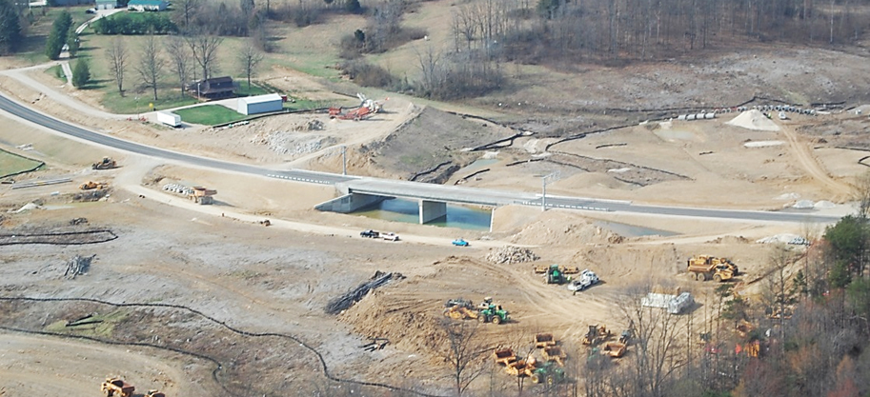
Progress: Sections 1-4
Sections 1-3
67 miles: I-64 to US 231 near Crane
9 years ahead of original schedule
Opened November 2012
Section 4
27 miles: US 231 to SR 37
Links 4-lanes from Evansville to Bloomington
Opened December 2015

Slide 36
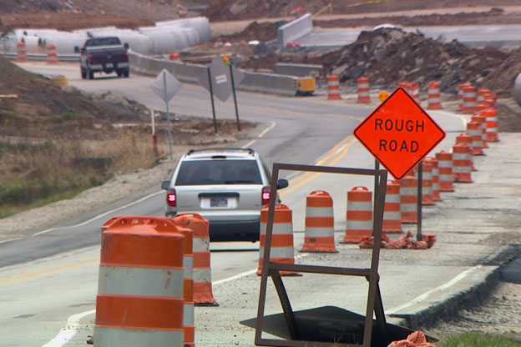
Progress: Section 5
Section 5
21 miles: Bloomington to Martinsville
P3 Availability Payment Procurement 2013-2014
Construction began fall 2014
Original completion date late fall 2016; est. July 2017
Delays and payment issues with contractor

Slide 37
Progress: Section 6
Section 6
26 miles: Martinsville to Indianapolis
Initially had 27 alternative routes; narrowed down to 14
In June announced 5 preliminary alternatives
March 29th announced the “reasonable alternative”
provides greatest regional congestion relief
provides greatest economic benefits
among the lowest cost alternatives
lowest impacts on wetlands, forest, and agricultural areas
strong stakeholder and public support compared to other alternatives
Preferred Alternative will be determined in early 2017
Selected Alternative will be determined in early 2018
ROD expected 1st quarter of 2018
Currently no funding but Governor committed to finishing I-69

Slide 38
Progress: Section 6 (cont.)

Slide 39
I-69 Bridge Update
Remains a tier-1 project in Blue Ribbon Panel on Projects
New analysis of tolling revenue shows the bridge is financially feasible in our preferred scenario
IN Roads and Transportation Chairman Ed Soliday will hold meetings about the bridge this summer
KY Governor Matt Bevin has included $28.8 million in funding over the next three years and is a supporter of the project

Slide 40
Connectivity, Collaboration, Capacity
“Connectivity lays the groundwork for empowerment and the framework for
innovation.”
--Global Innovation Report 2015
Working together to create traction across the state and beyond.

Slide 41
Michigan

Slide 42
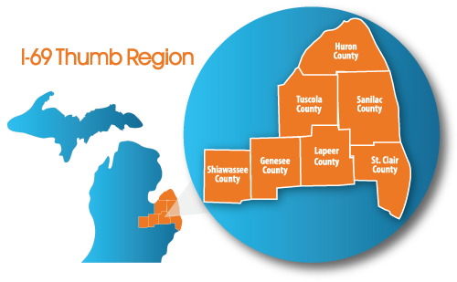
I-69 International Trade Corridor Next Michigan Development Corporation
About Us
We Grow it. We Move it. We Work it. We Enjoy it!
A collaboration of industry and government
35 municipal partners, 4 counties
Regional projects and regional branding
3 of 5 Next Michigan Development Corp.’s are located on I-69

Slide 43
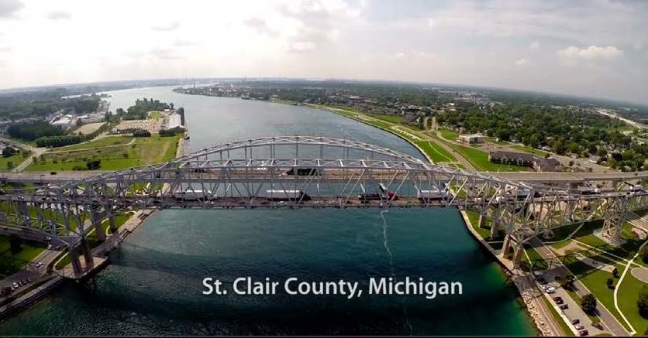
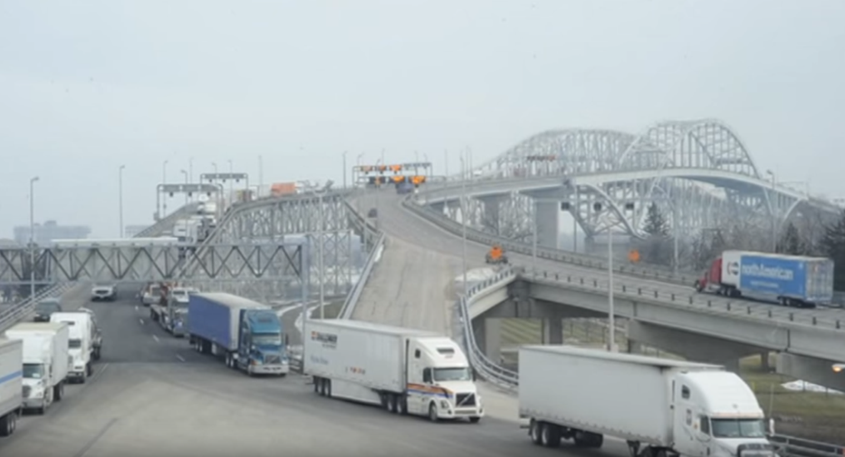
U.S./Canada Border Crossing
Blue Water Bridge Plaza & Corridor Improvements
I-96/I-69 Corridor, Black River Bridge - $90 million
I-96/I-69 Interchange & Welcome Center – $81.5 million
Proposed: 56-Acre Bridge Plaza and Corridor Expansion
Counter-Proposal: 34-acre Plaza Expansion – $165 Million
43

Slide 44
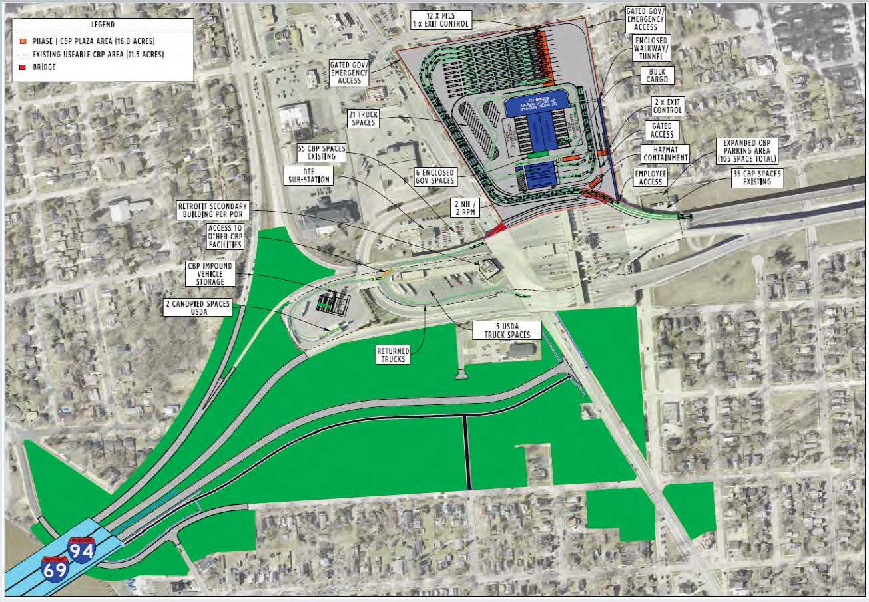
Blue Water Bridge Plaza Expansion Project
One of the busiest Commercial Corridors for International Truck Traffic
Pending Funding
Complete

Slide 45
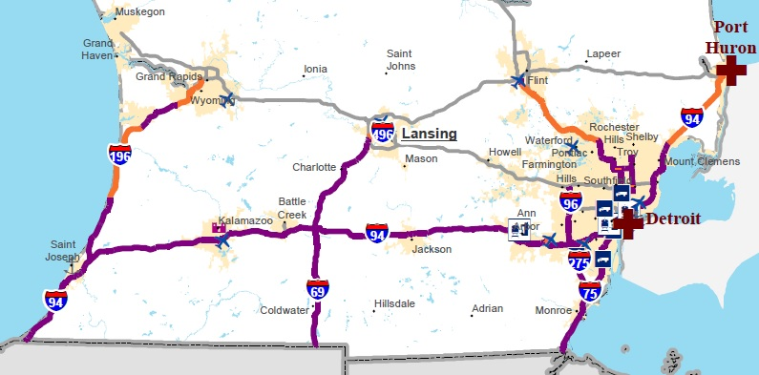
Primary Freight Network
First 122 Miles from Blue Water Bridge to Lansing Omitted
I-75 and I-94 Connections to I-69 Omitted
Region Waged Significant Public Input Campaign
Numerous DC Conversations Addressing Shortfall In Plan
45

Slide 46
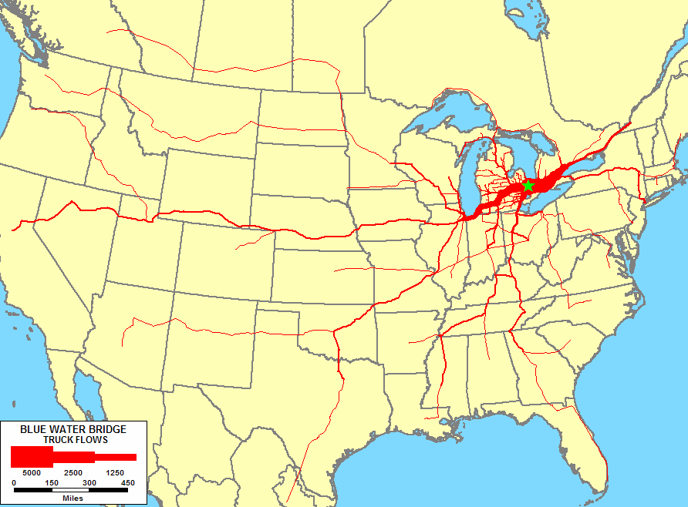
Traffic Flows
Blue Water Bridge averages 5.5 million crossings annually
Inbound and outbound traffic is about equal
46

Slide 47
A Freight Corridor Connecting the American Heartland

